Slide 1
PROFIT ANALYTICS PROJECT Project team ID-PTID-MAY-25-402
About Dataset:
Project Profit Analysis helps organizations evaluate and optimize their financial performance by analyzing key cost components such as R&D spending, administration, and marketing. By applying predictive models to these factors, businesses can estimate profits, identify inefficiencies, and develop strategies to boost return on investment. This kind of analysis is essential for informed budgeting, resource allocation, and long-term planning.
This particular dataset holds 17 columns and 78 records. The key columns include information such as R&D Spend, Administration Cost, Marketing Spend, State, as well as Profit, Predicted Profit, Observation number, and Residuals. The dataset also contains supplementary regression output, which includes statistical summaries and may support model validation and performance evaluation.

Slide 2
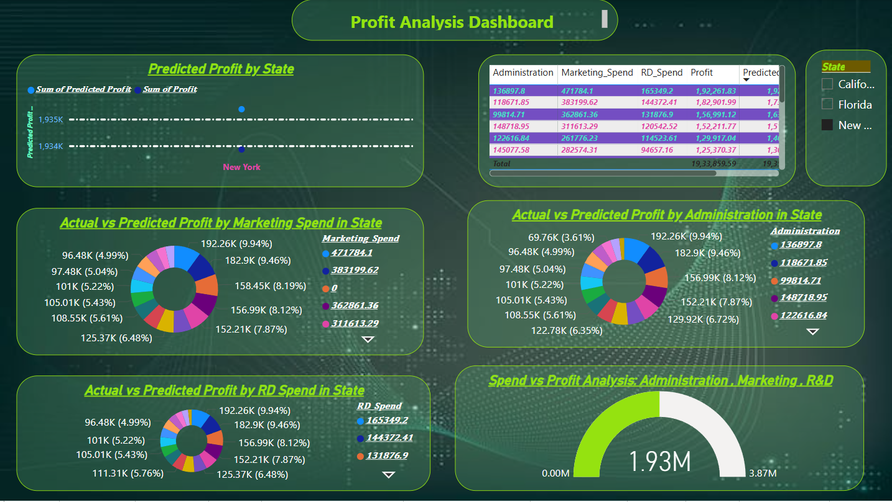
PROFIT ANALIYSIS DASHBOARD

Slide 3
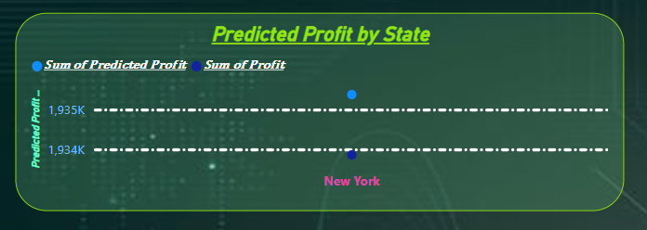
PREDICTED PROFIT BY STATE
Profit Overview:
The visual compares the predicted profit and actual profit for the state of New York. Both values are closely aligned, with predicted profit slightly exceeding actual profit—approximately 1.935K vs 1.934K (in thousands). This indicates a high accuracy in the predictive model for this state, suggesting that project profitability in New York is being effectively forecasted.

Slide 4
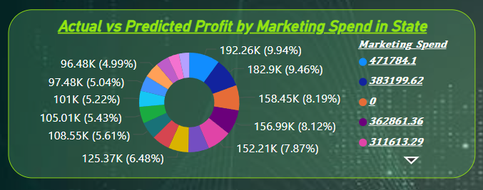
ACTUAL vs PREDICTED PROFIT BY MARKETING SPEND IN STATE
This chart compares actual vs. predicted profits by marketing spend across different states. It uses a donut chart to visually represent profit distribution, with values ranging from 96.48K to 192.26K. The highest marketing spend (471,784.1) correlates with the highest predicted profit. One state has zero marketing spend, indicating no investment in that area. The chart highlights how marketing spend influences profit outcomes across regions.

Slide 5
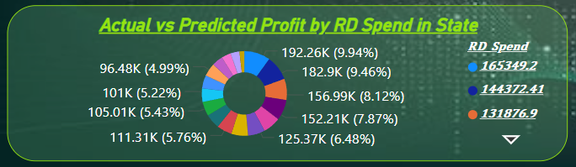
ACTUAL vs PREDICTED PROFIT BY RD SPEND IN STATE
It contains a donut chart comparing actual and predicted profits as a percentage of RD (Research & Development) spending across different states. The chart includes data labels with profit values and percentages, as well as a legend indicating actual and predicted spend using different colored dots. The slide appears to be part of a business or financial presentation analyzing the relationship between RD spend and profit outcomes.

Slide 6
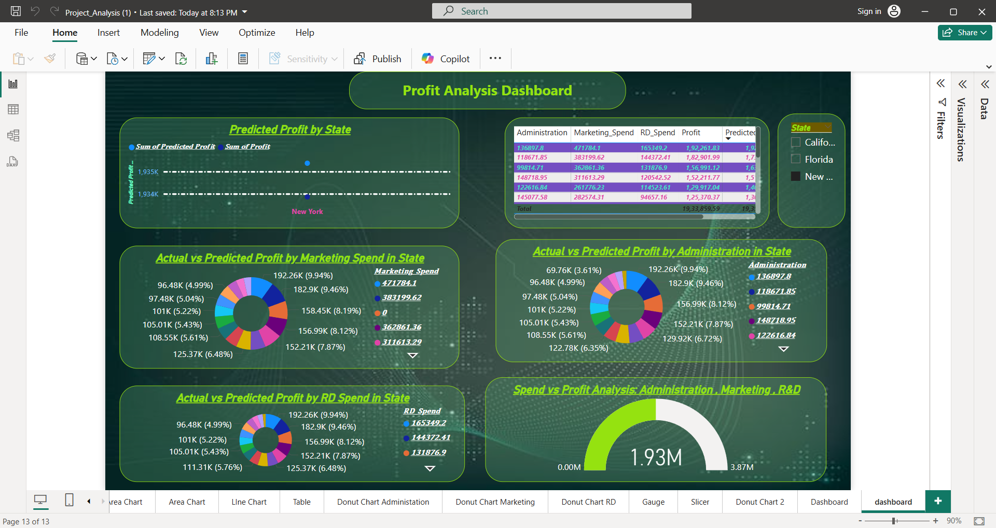
ACTUAL vs PREDICTED PROFIT BY ADMINISTRATION IN STATE
It visually compares the actual profits versus predicted profits across various administrative spending levels. The chart includes values in thousands (K) and percentages, showing how each administration data point contributes to the total.
Examples:
192.26K (9.94%)
182.9K (9.46%)
156.99K (8.12%)
On the right, a legend maps colors to specific administration spending values like 136897.8, 118671.85, 99814.71, etc. This helps link profit contributions to their respective administration figures.

Slide 7
SPEND vs PROFIT ANALYSIS:Administration, Marketing,R&D
The chart visualizes the total profit, which is marked at 1.93M on a scale ranging from 0.00M to 3.87M. The needle pointing to 1.93M suggests the current or achieved profit relative to a higher potential target.
The chart effectively highlights the performance or ROI from combined departmental spending.

Slide 8
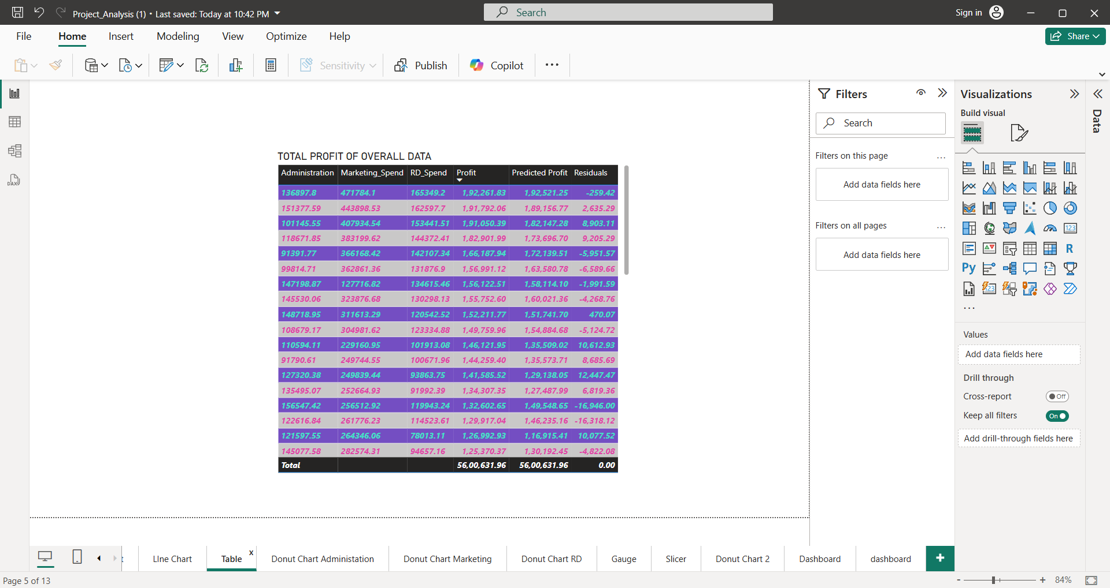
TOTAL PROFIT OF OVERALL DATA
The table includes financial metrics such as:
Administration
Marketing Spend
R&D Spend
ProfitPredicted Profit
Residuals (difference between actual and predicted profit)
The total values at the bottom show:
Total Profit: ₹56,00,631.96
Total Predicted Profit: ₹56,00,631.96
Total Residuals: 0.00

Slide 9
ACTIONABLE RECOMMENDTIONS
This Profit Analysis Dashboard provides a strong overview of how Administration, Marketing, and R&D spending impacts profit across different states. Based on the visual insights, here are actionable recommendations:-
1. Optimize R&D Spending
The highest profit contributors are linked to R&D spend above 150K, particularly at 165,349.2 and 144,372.41.
Recommendation: Focus on maintaining or increasing R&D investment in these ranges to boost profitability further.
2. Improve Administrative Efficiency
Administrative costs like 136,897.8 and 118,671.85 yield high predicted profits, but lower ranges show declining returns.
Recommendation: Conduct a cost-benefit analysis for administrative expenses to identify overspending areas with low ROI.
3. Refine Marketing Strategy
Profit doesn’t increase linearly with marketing spend. For example, Marketing Spend = 0 still shows notable predicted profit (158.45K).
Recommendation: Re-evaluate campaigns and redirect marketing budget to only the most effective channels.
4. Target High-Profit States
New York alone shows high predicted and actual profits (~1.935M).
Recommendation: Scale successful strategies used in New York to underperforming states (like Florida and California, if shown in full data).
5. Narrow the Prediction Gap
Residuals indicate discrepancies between actual and predicted profits. Some data points show high residuals.
Recommendation: Enhance the prediction model by refining features or including more variables for better accuracy.
6. Monitor Overall Profit Growth
The gauge shows current profit at 1.93M, halfway to the goal of 3.87M.
Recommendation: Set quarterly targets to bridge the gap and align departmental spending with those targets.

